Slide 1
L’interconnectivité des générations pour propulser APN
Par Yves Proteau et Antoine Proteau

Slide 2
Source: https://www.the-fulcrum.com/

Slide 3
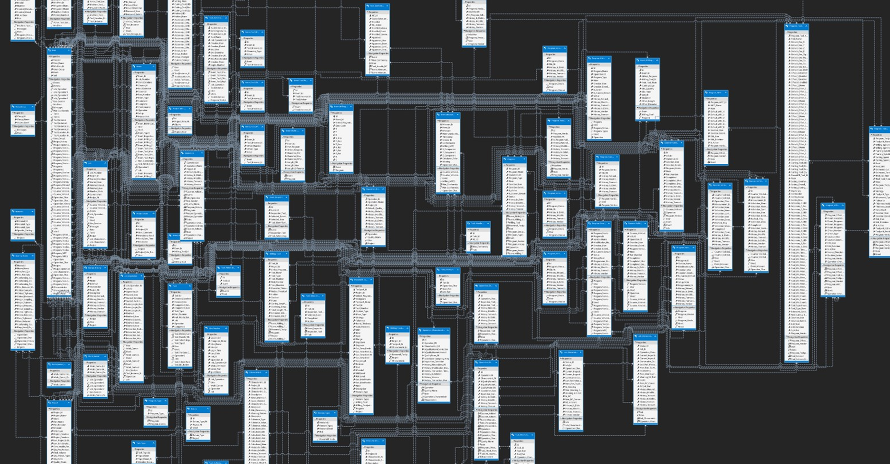
Source: https://www.the-fulcrum.com/

Slide 4
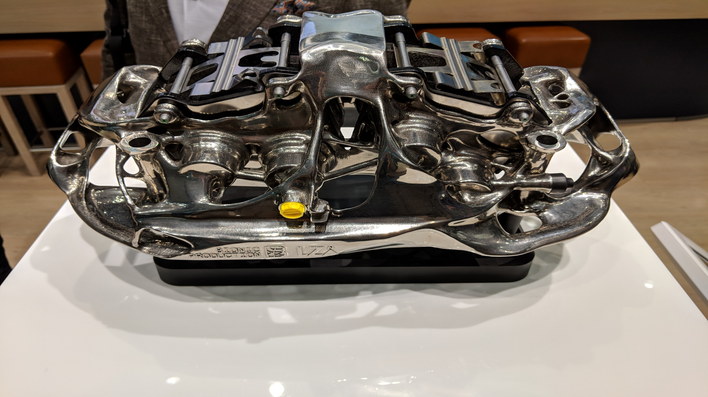
Source: Hannover Messe – Kiosque Fraunhofer

Slide 5
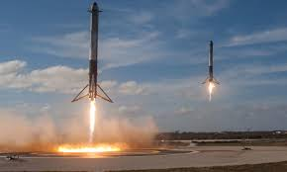
Source: Hannover Messe – Kiosque Fraunhofer

Slide 6
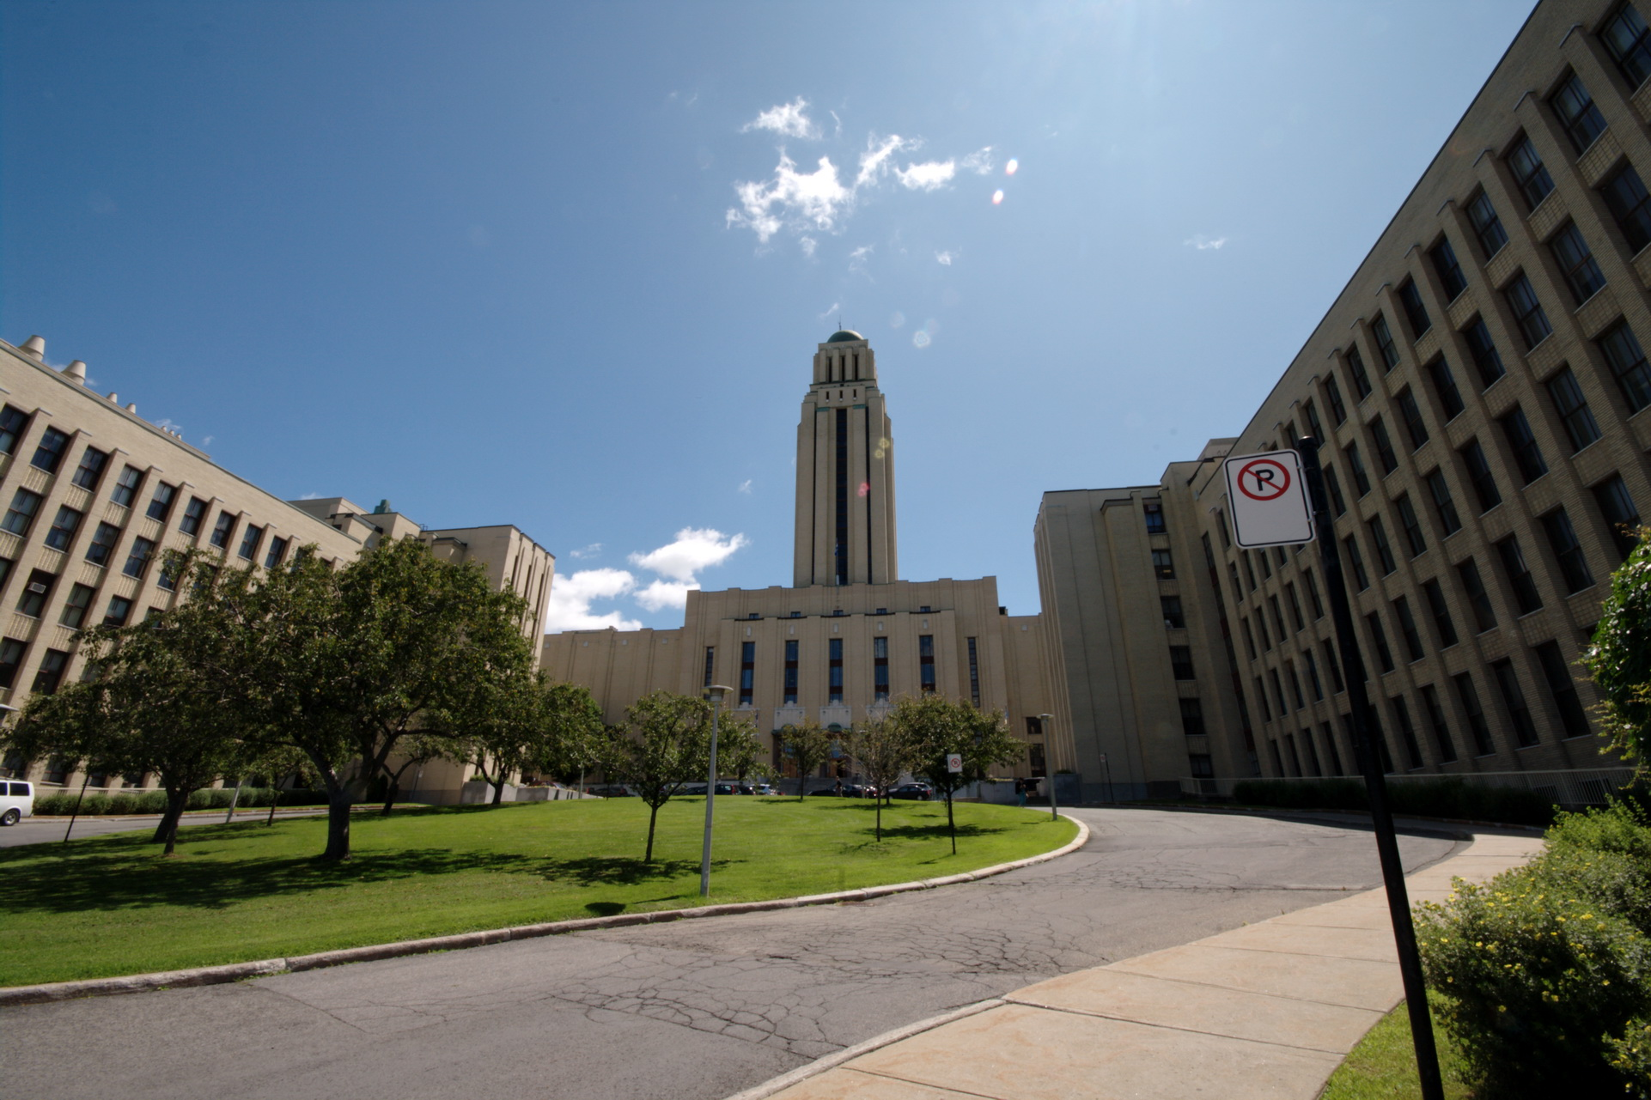
Source: https://lesbeautesdemontreal.com

Slide 7
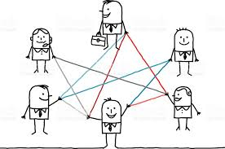
Source: https://lesbeautesdemontreal.com

Slide 8
Source: https://renaissanceforleaders.com

Slide 9
Source: https://renaissanceforleaders.com

Slide 10
Source: http://nicolecrank.com/

Slide 11
Source: http://nicolecrank.com/

Slide 12
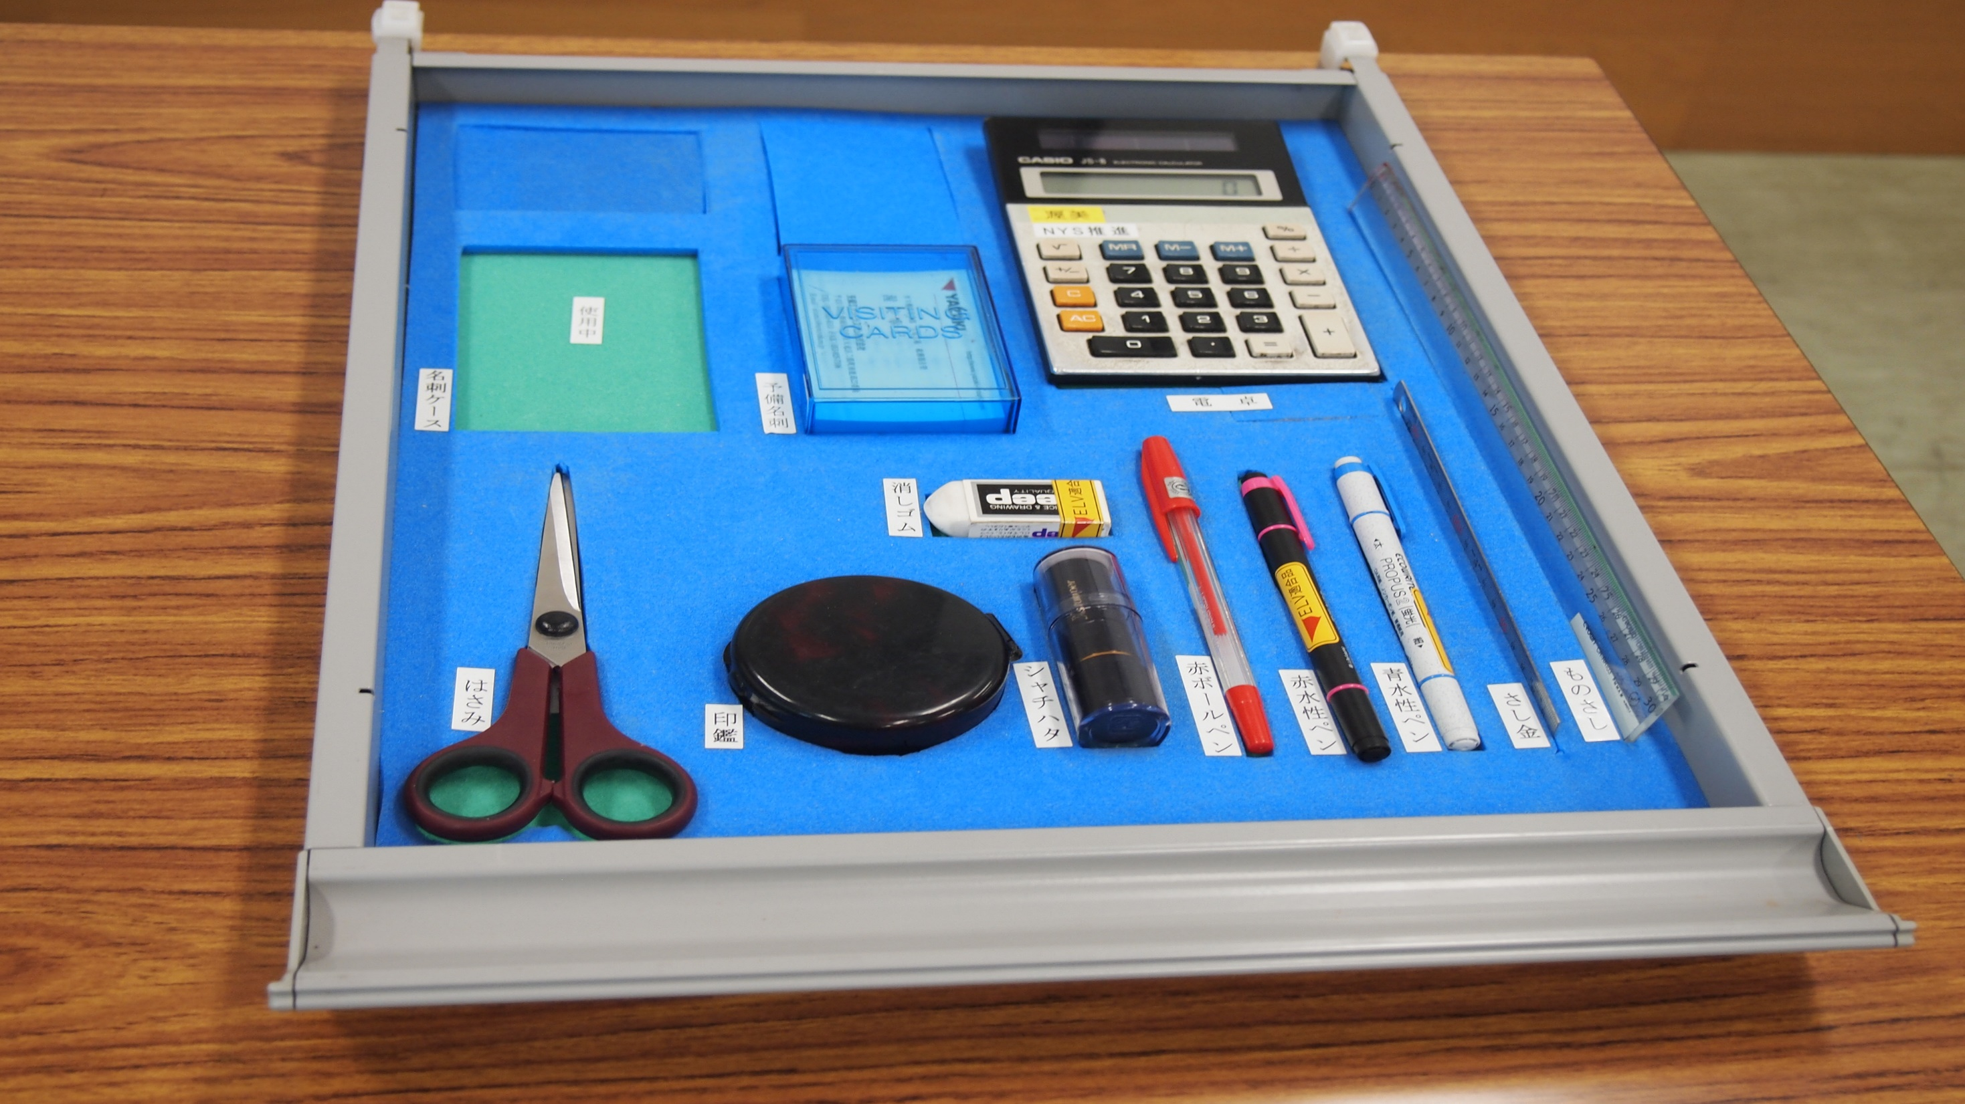
Source: https://www.pinterest.com

Slide 13
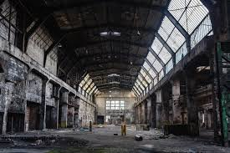
Source: https://www.pinterest.com

Slide 15
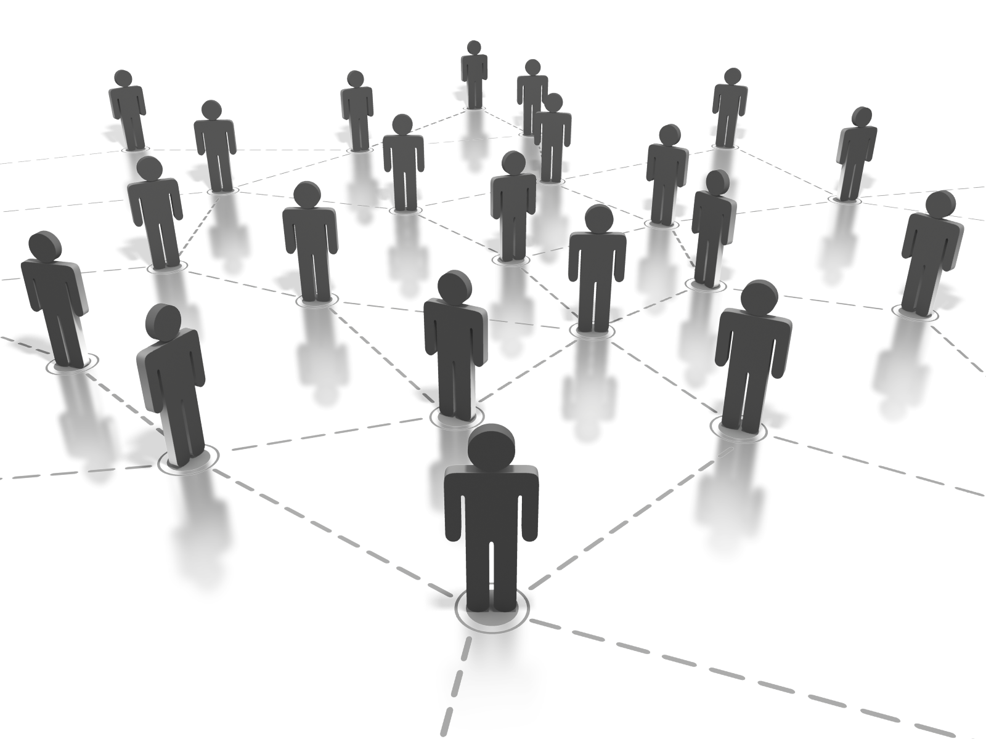
Source: https://imstt.com/

