Slide 1
EXTRACT VALUE FROM IoT EQUIPMENT DATA

Slide 2
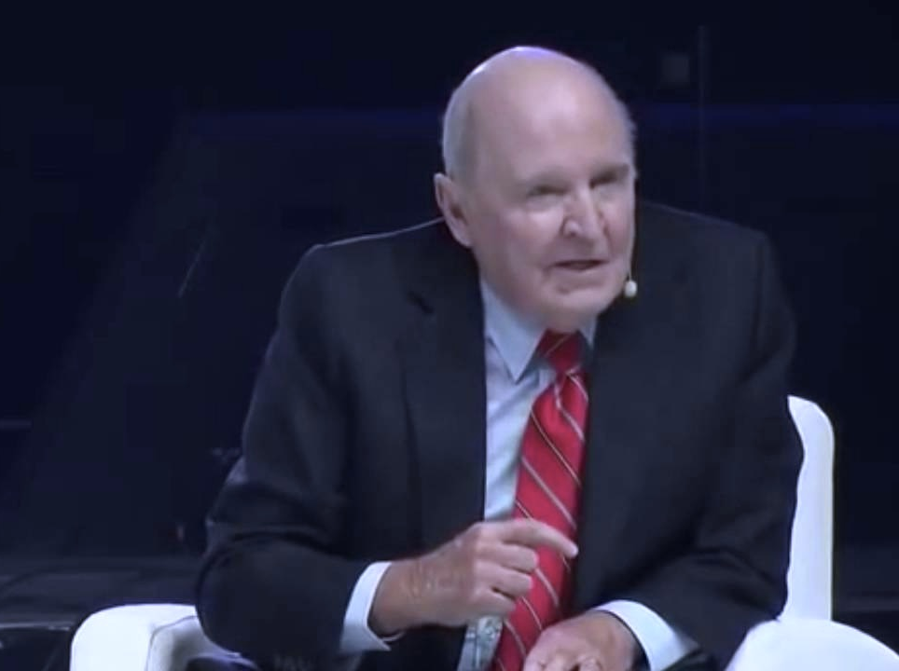
EQUIPMENT MANUFACTURER
SOFTWARE PROVIDER
THERE IS A GAP THAT NEEDS TO BE BRIDGED

Slide 3
IT'S A FIGHT TO COMPETE, TO DIFFERENTIATE, TO INNOVATE....AND TO SURVIVE

Slide 5
DOMAIN EXPERT
TECHNOLOGY EXPERT

Slide 6
Autonomous Assets
Artificial Intelligence
Contextualization
Measurability
Visibility
Collection

Slide 7
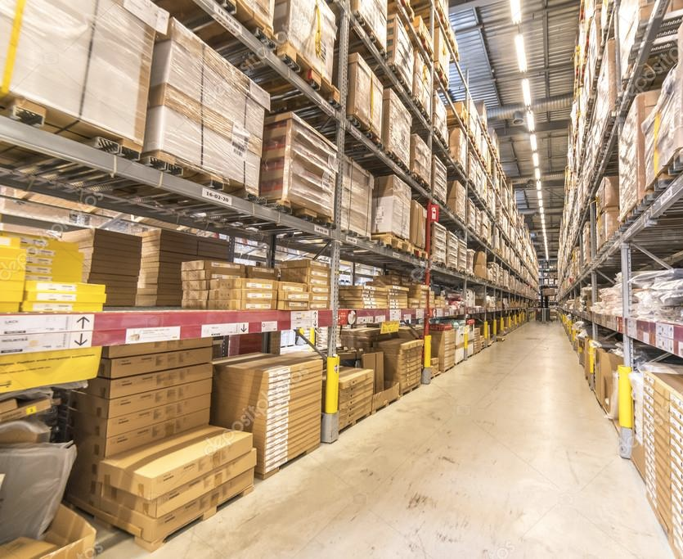
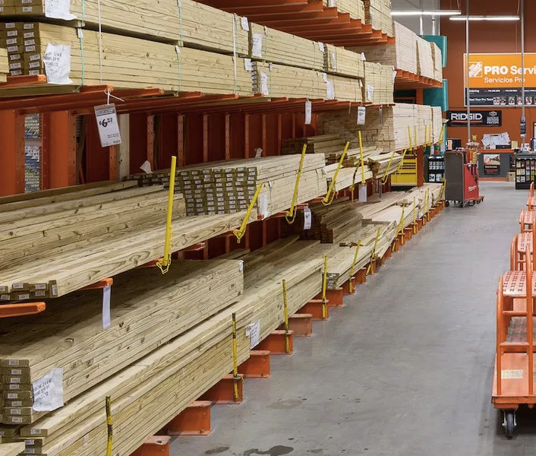
OUT-OF-THE-BOX
DO IT YOURSELF

Slide 8
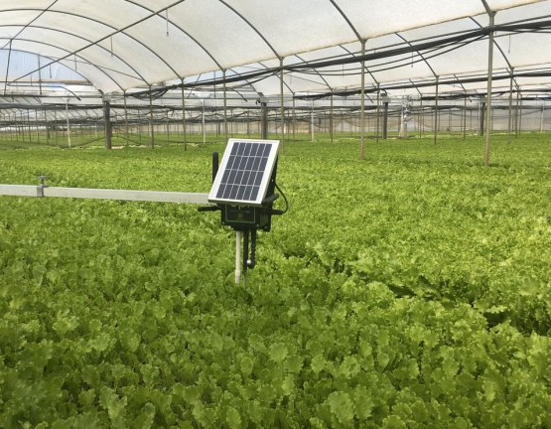
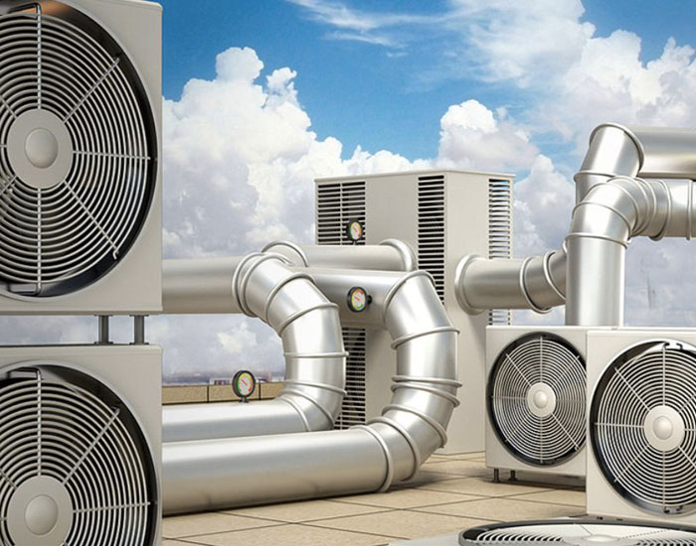
MNUBO IS THE IoT DATA EXPERT
DELIVERING BUSINESS INSIGHTS TO 120+ PRODUCT TYPES

Slide 9
HOW TO GET STARTED ON YOUR IoT AND AI JOURNEY

Slide 10
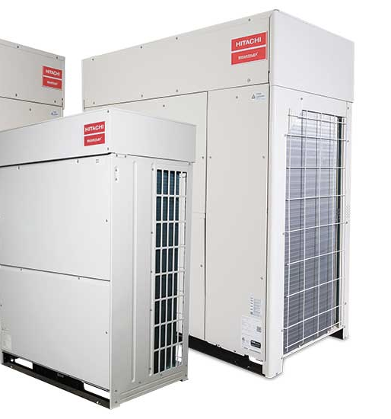
MECHANICAL INTELLECTUAL PROPERTY
SELL THROUGH CHANNELS & DISTRIBUTORS
HARDWARE REVENUES, RARELY SERVICES

Slide 11
MECHANICAL INTELLECTUAL PROPERTY
WE NEED TO BE A
SMART MANUFACTURER
SELL THROUGH CHANNELS & DISTRIBUTORS
HARDWARE REVENUES, RARELY SERVICES

Slide 12
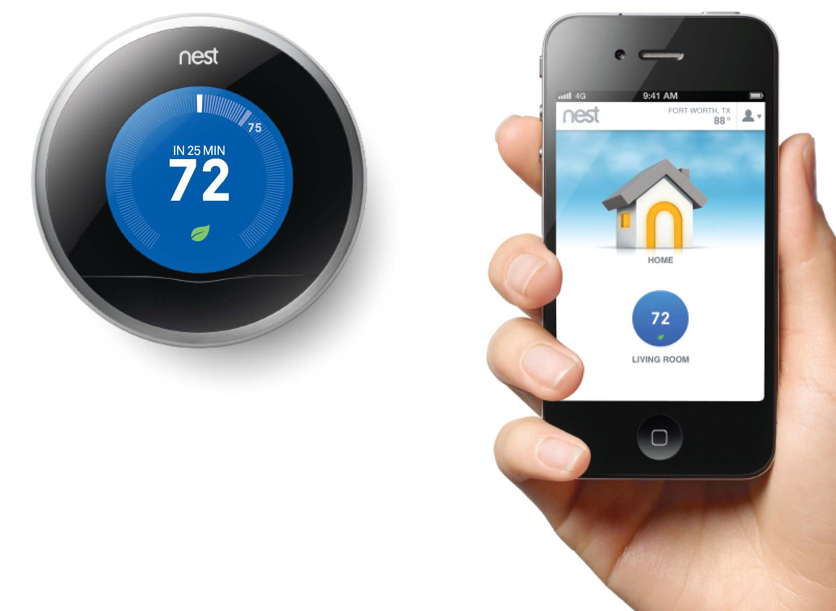
THE IoT IS NOT MOBILE APPS, THE IoT IS INTELLIGENCE

Slide 13
BUILD MONETIZABLE SERVICES ON TOP OF IoT ASSETS

Slide 14
THE WINNERS WILL BE THE ONES WHO CAN
MAXIMIZE THE IoT INTELLIGENCE

