Slide 1
Business environment and Investment opportunities in the Republic of Moldova (Montreal, May 11, 2017)
Ambassador of the Republic of Moldova to Canada
Ala Beleavschi

Slide 2
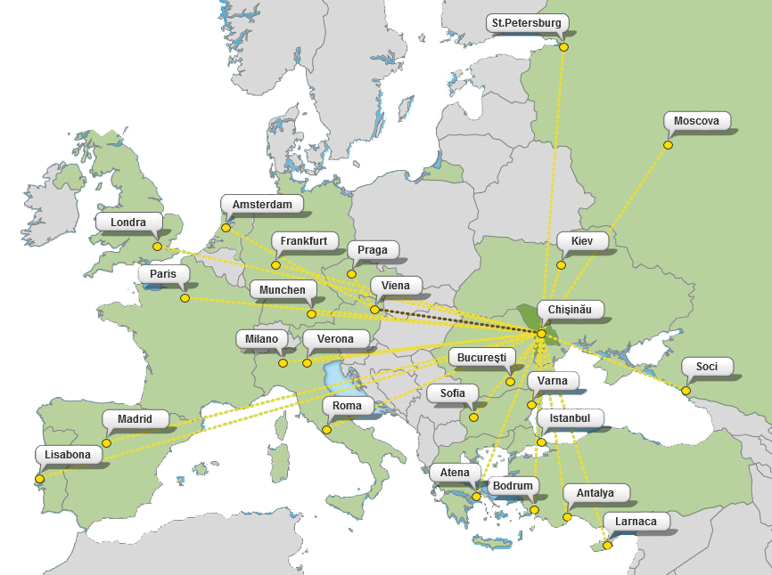
Republic of Moldova a bridge between East and West

Slide 3
Republic of Moldova - Overview
GDP growth rate
4.1% (2016)
Unemployment rate
4.2 % (2016)
Inflation Rate
(annual average)
6.4% (2016)
GDP in current prices
6.75 bil. USD (2016)
GDP per capita
2519 USD (2016)
Source: National Statistics of Moldova

Slide 4
Republic of Moldova - GDP per capita based on purchasing-power-parity in current prices

Slide 5
Regional integration efforts
Member of WTO
Member of CEFTA
EU ATP
Member of CIS
Free Trade Agreement with Turkey
Free Trade Agreement with EU
DCFTA
EU
505 mil. people
CEFTA
22 mil. people
CIS
279 mil. people
Access to the market
806 mil. people

Slide 6
Top Reasons to Invest and Outsource in Moldova (1)
Favorable geographical location
Time and cultural proximity – situated within 3 hours distance from all main European Hubs.
Time compatibility – the standard time zone is UTC/GTM +2 hours which offers great compatibility with all European countries and most of the CIS countries.
Cost Efficient Destination
Low operational costs – rent prices for offices, utilities.
Lowest labor cost in Europe – low wages at all levels for skilled and talented specialists.
Direct flights – to and from Vienna, Munich, Frankfurt, Rome, Milano, Paris, London, Moscow, etc.
Visa liberalization regime – no visa is needed for USA, Canada, EU and CIS citizens traveling to Moldova.
Small Tax load – personal and corporate income taxes, social security contributions.
Cost of living – is lowest in the region. Chisinau – cheapest city in Europe.
Corporate income tax (CIT) – is as low as 12%, while incentives for the IT sector exempt from most taxes on gross salaries above USD 680.

Slide 7
Top Reasons to Invest and Outsource in Moldova (2)
Human Resource Availability
Multilingual population – Moldova’s population speaks at least one foreign language beside Romanian: Russian, English, German, French, etc.
Strong industrial tradition – and technical education, scientific research.
Communication facilities – the country’s internet speeds are among the fastest in Europe and enable easy communication with the rest of the world. The advantage is great not only for accessing remote applications and databases, but also for IP telephony.
Work force – 1500 students graduate Moldovan universities yearly with degrees in computing and related fields. Another 5000 have math or engineering degrees.

Slide 8
Moldova’s comparative advantages
Corporate income tax (CIT)
12 %
CIT rates
6 %
0 %
Value added tax – standard rate
20 %
8 %
VAT rates
0 %
Social insurance contributions
Source: PriceWaterhouseCoopers

Slide 9
Trade balance (2016) &
Trade forecast (2018)
Trade volume in 2016: 6065.7 mln. USD
Export: 2045,3 mln. $ Import: 4020.4 mln. $ EU: 1332.4 (65,1%) UE: 1973.7 (49.1%)
CIS: 414.2 (20,3%) CIS: 1027.4 (25,6%)

Slide 10
Bilateral Product trade Canada – Moldova Sourse: Statistics Canada
Year | Exports | Imports
2012 | $1,181,382 | $3,460,776
2013 | $4,124,458 | $3,362,885
2014 | $4,545,366 | $4,679,207
2015 | $1,656,854 | $9,911,292
2016 | $1,141,731 | $10,320,188

Slide 11
Product Trade Canada – Moldova 2016 Sourse: Statistics Canada

Slide 12
Foreign Direct Investments

Slide 13
DOING BUSINESS Measuring Business Regulations
Economy | Rank | Starting a Business - Time (days)
Lithuania | 21 | 5.5
Romania | 36 | 12
Bulgaria | 39 | 23
Russian Federation | 40 | 11
Croatia | 43 | 7
Moldova | 44 | 6
Serbia | 47 | 7
Turkey | 69 | 6.5
Ukraine | 80 | 5
Bosnia and Herzegovina | 81 | 65
Source: The World Bank

Slide 14
Fiscal incentives
A. Incentives when starting a business
No minimum capital requirement when starting a business.
VAT refund for capital expenses on long-term investments, except for housing and vehicles
VAT and customs tax exemption for assets to be included in the share capital of the company.
Benefits when operating
12% Corporate Income Tax – since 2012, with incentives for investors
Double Taxation Avoidance Agreements (DTAA ) with 45 countries, including Canada (since 2002)
Employers will not pay taxes for the sums spent for food, transport and training of employees.
Facilities when exporting
Companies importing raw material benefit from VAT and custom tax vacation if they subsequently export the final product within 180 days.

Slide 15
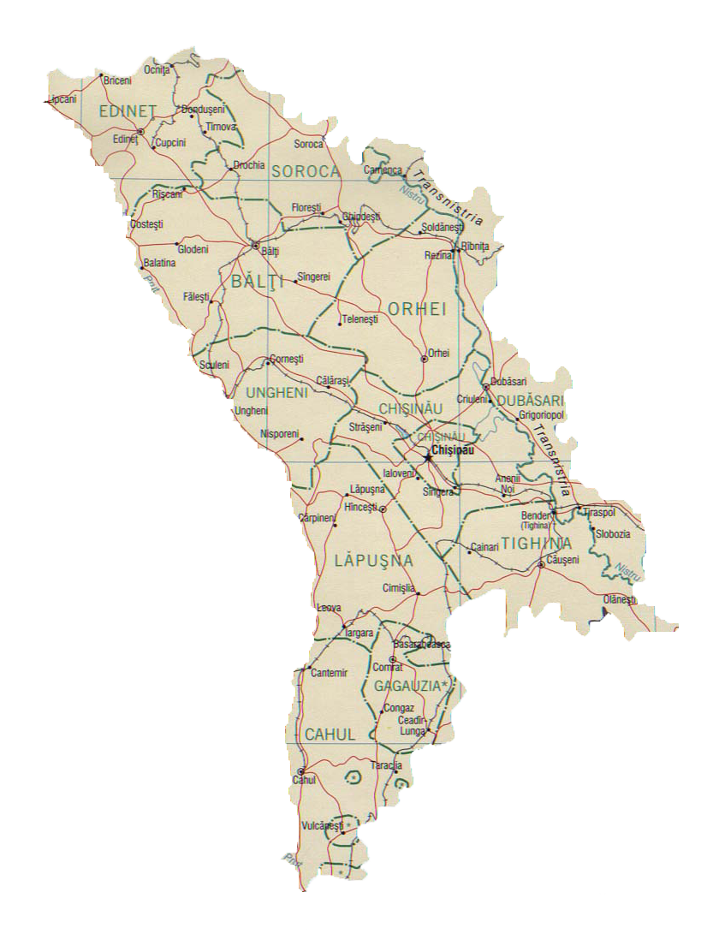
Free Economic Zones (FEZ)
Otaci Business
50% of national corporate income tax
3 and 5 years income tax exemption if investing 1 and 5 million USD accordingly
Balti
Ungheni
Business
Expo Business Chisinau
VAT and excise duties exemption
Tvardita
10 years state warranty if changing the legislation
Giurgiulesti International Free Port
Taraclia
Vulkanesti

Slide 16
Industrial Parks (IP)
Facilities for administration company and the residents of IP
Changing the destination of agricultural land is for free
The right to privatize the state-owned land for construction at normative price
Free allocation of public property assets to create parks at owner's decision
Decreasing up to 70% the annual fee regarding land lease or space rent
9 Industrial Parks

Slide 17
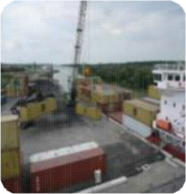
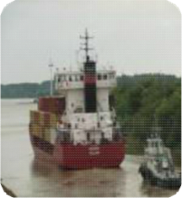
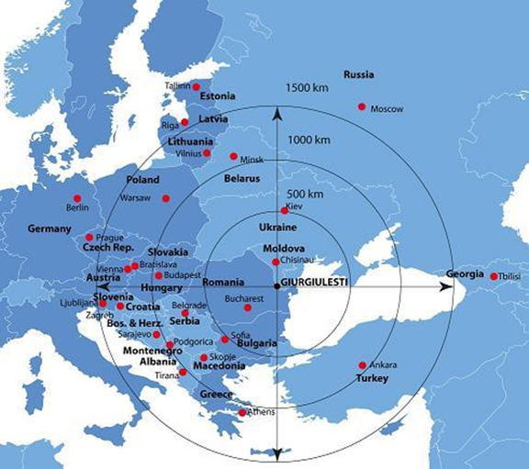
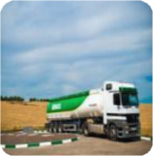
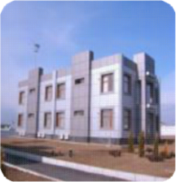
Giurgiulesti International Free Port (GIFP)
GIFP
Port operations
Forwarding
Short sea;
River shipping
Inland transportation
Giurgiulesti International Free Ports’ entire territory has a status similar to free economic zone.

Slide 18
Investment attraction & export promotion priority sectors
Information and Communication Technologies
Automotive: wiring harness , pumps, testing equipment etc.
Business Process Outsourcing: call centers and other outsourcing activities to support business
Manufacture of machinery and spare parts
Textile: footwear, clothing, leather processing
Electric devices
Agriculture & Food processing

Slide 19
IT & Communications
sector with a very rapid development;
high penetration of fixed telephony (33%);
high penetration of mobile telephony; 3 operators; 3G & 4G;
high penetration of cable TV;
broadband Internet and IP TV - growing areas (no. 15 in the world);
high speed loading data - no. 6 in the world
qualified human resources - incentive for IT companies

Slide 20
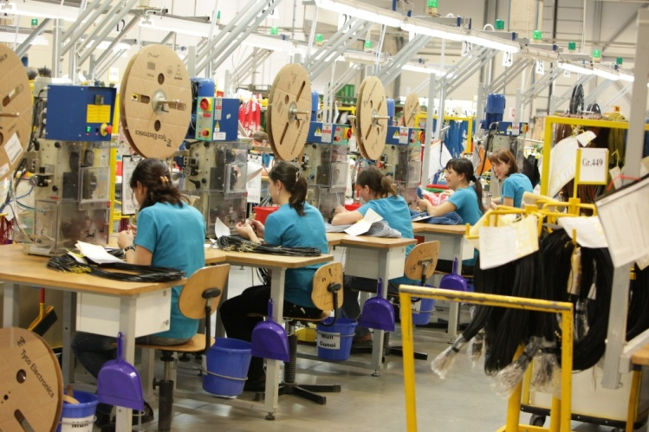
Automotive Industry
Automotive components that can be produced competitively in Moldova
Electronic components and systems
Fastening systems (seatbelts)
Rubber components
Injection/Molded parts
Cable assemblies and wiring harnesses
Car seat covers, trim
Foams/Felts
Carpets/Rugs
Success Stories
Prevent (Germany, Seating/trim) – first automotive supplier in Moldova, production since 2000
Lear Corporation (USA, Seating/ trim) – 1st plant in 2010
Draexlmaier Automotive (Germany, wiring harnesses) – 1st plant in 2007, 2nd plant in 2009, 3rd plant planned for 2016;
Gebauer & Griller – (Austria, cables) – plant construction 2012, production launched July 2013.
Leoni (Germany, wiring harnesses) – local subcontractor since 2010

Slide 21
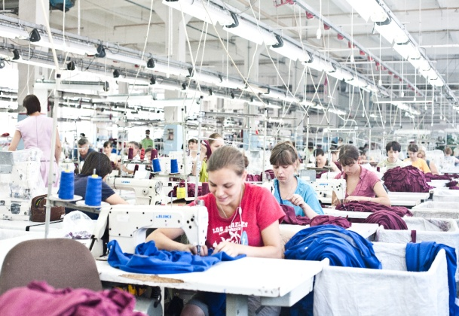
Textile Industry
Goods that can be produced
competitively in Moldova
Success Stories
Moldovan manufacturers have been working for many years with renowned foreign brands – both fashionable and mass market brands. Companies from Italy, Germany, Netherlands, France, Austria, Belgium, and Great Britain
produce here.
The reason: Moldova offers a high level of quality production and a high speed in command processing
Textile
Apparel
Leather
Accessories
Icatex Pro – a subsidiary of the Team dress Group (Germany), manufactures medical clothing for the
health care sector and corporate clothing for the catering sector.
Footwear
Carpets

Slide 22
Agriculture & Food processing
Agriculture products that can be produced competitively in Moldova
¾ of the country's area - agricultural land, 72% is arable land;
fertile soil: ¾ arable lands are chernozem (among the most fertile in the world);
diffuse sector - many small farmers
consolidation - great opportunities for investors;
specialization in agricultural niche products and the food industry (nuts, dried fruit, fresh fruit, wine sector, etc.).
Viticulture and Wine
Fruits and Vegetables
Cereal Crops
Walnut Growth
and Sorting
Sugar Production
Oleaginous Plants
Organic Farming

Slide 23
Success stories

Slide 24
Thank you for your attention!
Embassy of the Republic of Moldova
275 Slater Street, Suite 801, Ottawa, ON K1P 5H9
Tel.: + 1 613-695-6167 Fax: +1 613-695-6164
ottawa@mfa.md | www.canada.mfa.md

Slide 25
CORRUPTION PERCEPTIONS INDEX 2016
Rank | Country/territory | 2016 Score | 2015 Score | 2014 Score | 2013 Score | 2012 Score
57 | Romania | 48 | 46 | 43 | 43 | 44
123 | Moldova | 30 | 33 | 35 | 35 | 36
131 | Russia | 29 | 29 | 27 | 28 | 28
131 | Ukraine | 29 | 27 | 26 | 25 | 26
CORRUPTION PERCEPTIONS INDEX RANKS IN COMPARISON PER YEARS
Country/territory | Rank
 | 2016 | 2015 | 2014 | 2013 | 2012 | 2011
Romania | 57 | 58 | 69 | 69 | 66 | 75
Moldova | 123 | 103 | 103 | 102 | 94 | 112
Russia | 131 | 119 | 136 | 127 | 133 | 143
Ukraine | 131 | 130 | 142 | 144 | 144 | 152
Source: Transparency International

